Slide 1


Slide 2
Zenith
ZETA

Slide 3



Who’s presenting?
Ayu
John
Tammie
Zenith

Slide 4



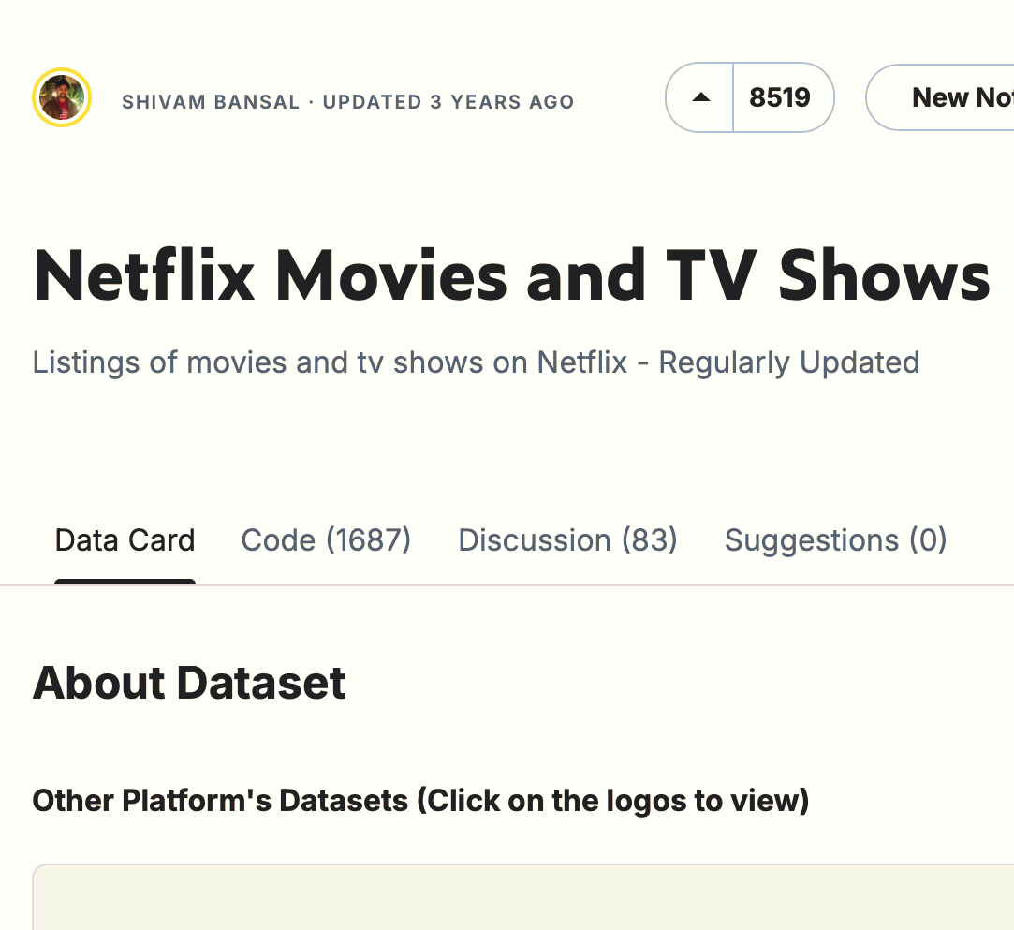





Zenith
Home Recently Added My List
Background
2024
3 seasons
Outline
We will be sharing the scope of our project including problem statement, assumptions, objectives, use cases, source of data, tools used, methodology of ETL process, data analysis, and limitations.
Problem Statement
Objectives
Assumptions
Use cases

Slide 5
Problem Statement

Slide 6
Analyze the distribution of genres in Netflix's catalog over time
PROBLEM STATEMENT

Slide 7
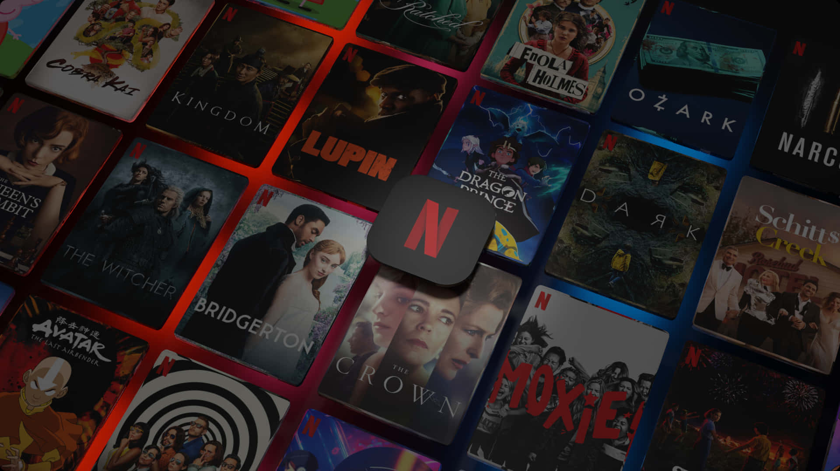




Analyze the distribution of genres in Netflix's catalog over time
Cater to diverse and growing audience
Staying ahead of competition
Distribution of genres and its evolution
Make informed decisions
PROBLEM STATEMENT

Slide 8
Objectives
Which genres have become more or less popular over the years?
What are the most common genres in Netflix's catalog?
How do genre preferences vary across different countries?
Which countries are producing the most diverse set of genres?
How can these insights inform Netflix’s content strategy, including content acquisition, production, and regional marketing efforts?

Slide 9
Assumptions
1
Netflix dataset consists of popular titles (Movies/TV shows) from 2018 to 2021
2
Existing demand for the titles if it is already streaming on Netflix.
3
Missing dates (NaT) found for date_added assumed to be “2018-12-31”.
4
Missing ratings for show_id: 5542, 5795, 5814 assumed to be the same “TV-MA”.

Slide 10
Use Cases

Slide 11
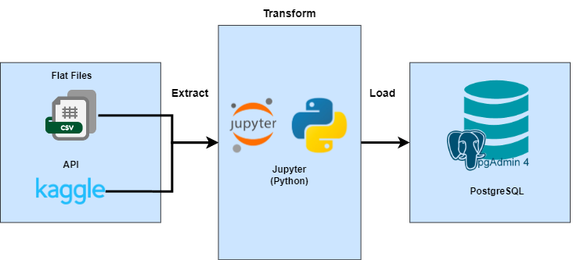
Data Architecture Diagram
USE CASES

Slide 12
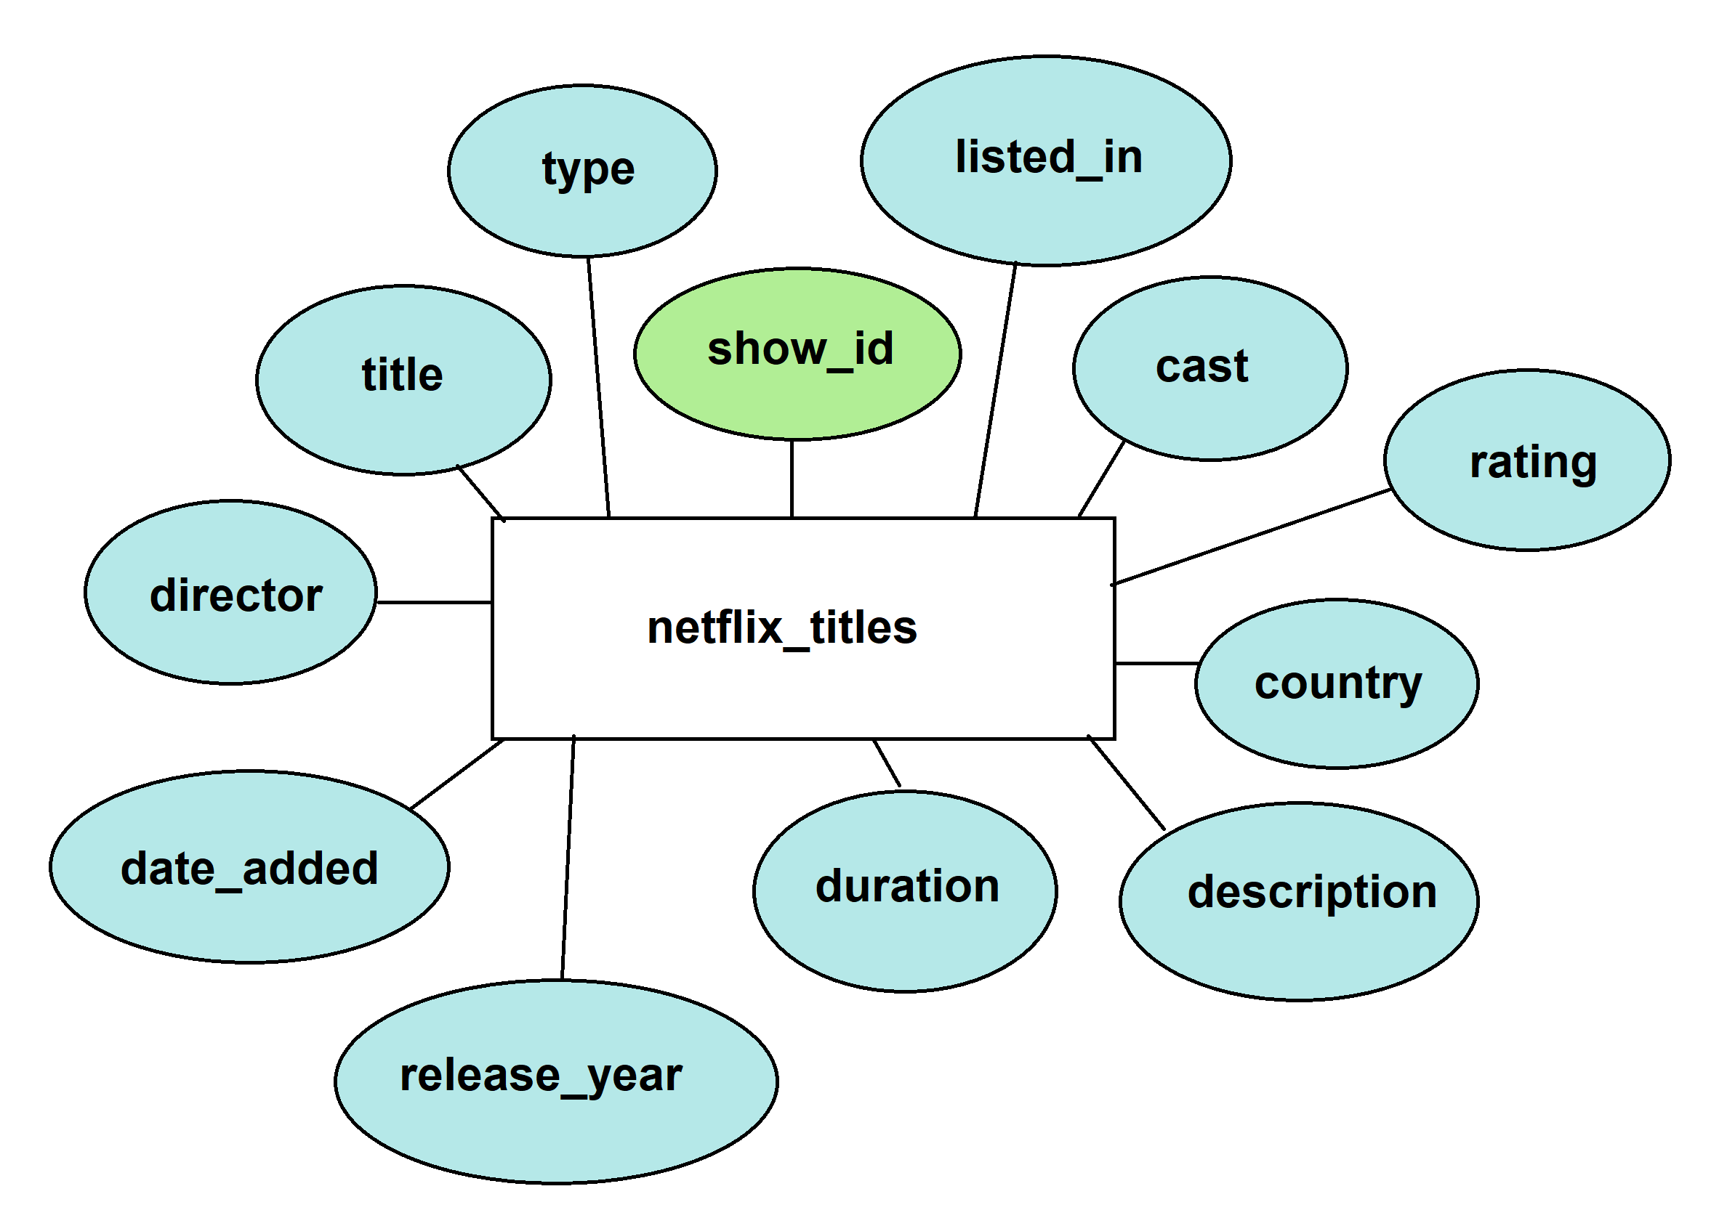
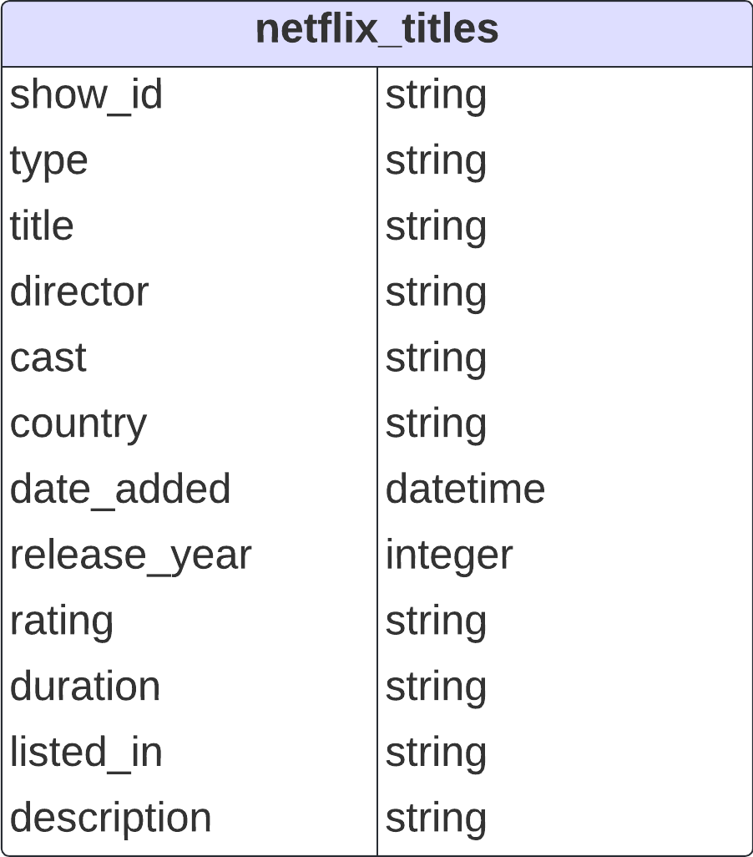
Conceptual Diagram (Initial)
USE CASES

Slide 13
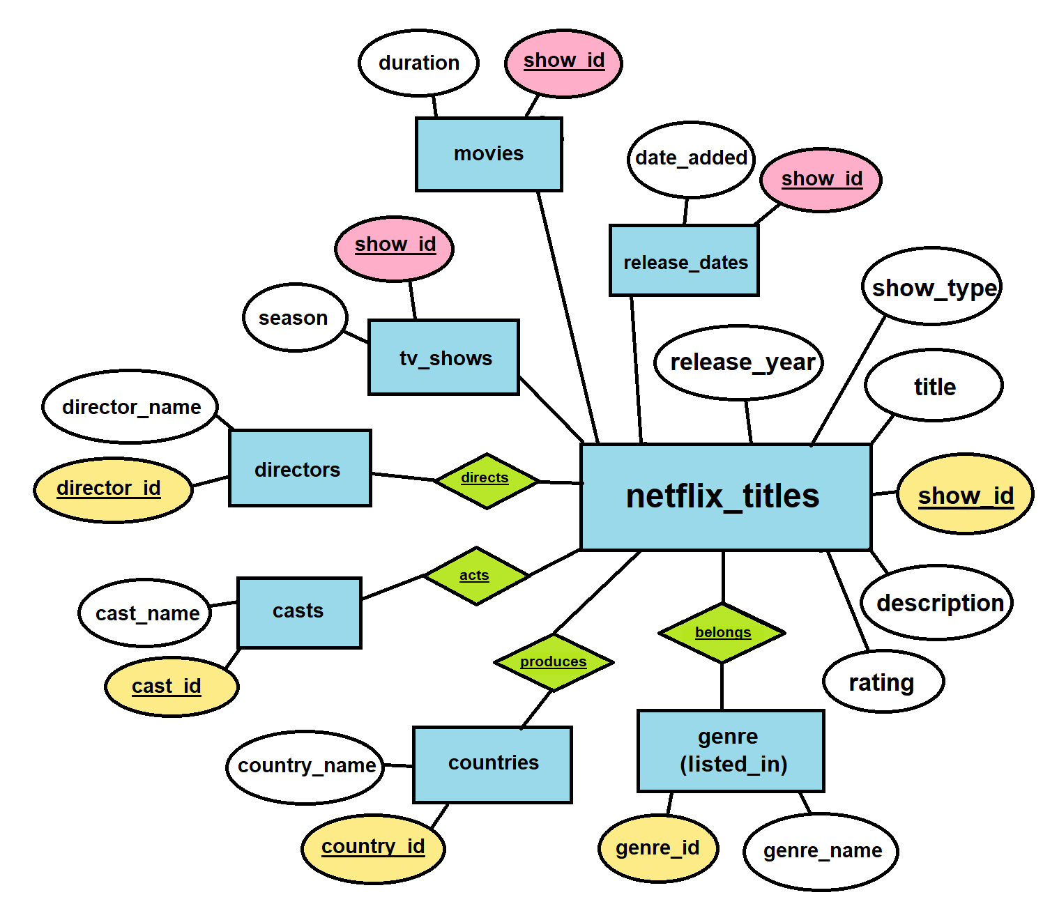
After Normalisation (3NF)
12 Tables
PK/FK set
USE CASES

Slide 14
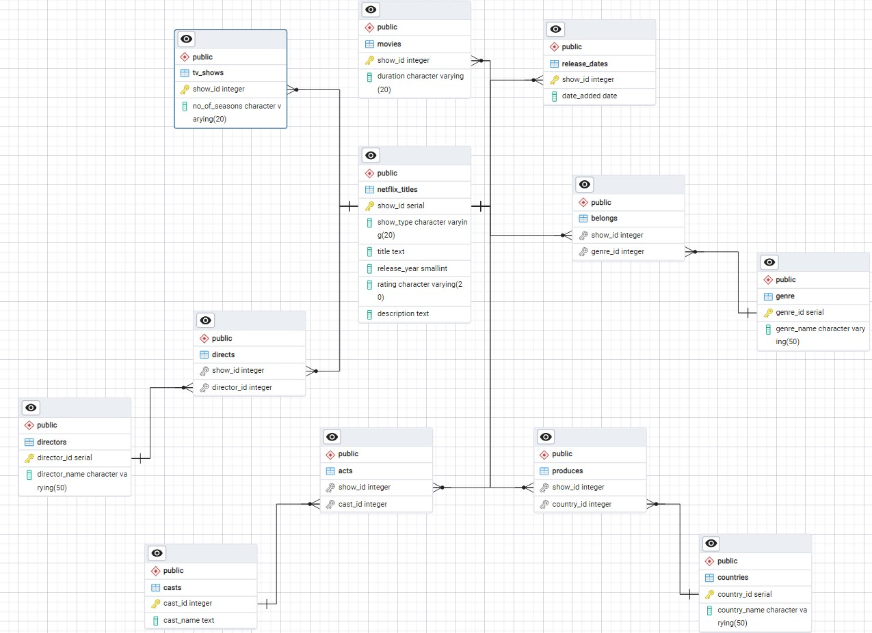
Entity Relationship Diagram
USE CASES

Slide 16



EXTRACT
TRANSFORM
LOAD
Kaggle API > get Netflix dataset (by Shivam Bansal)
pandas
numpy for np.nan
psycopg2 + SQLAlchemy
Create database
Create tables
Set PK/FK constraints & referential integrity
Load into Postgres
TOOLS USED

Slide 17
Data Visualization

Slide 18
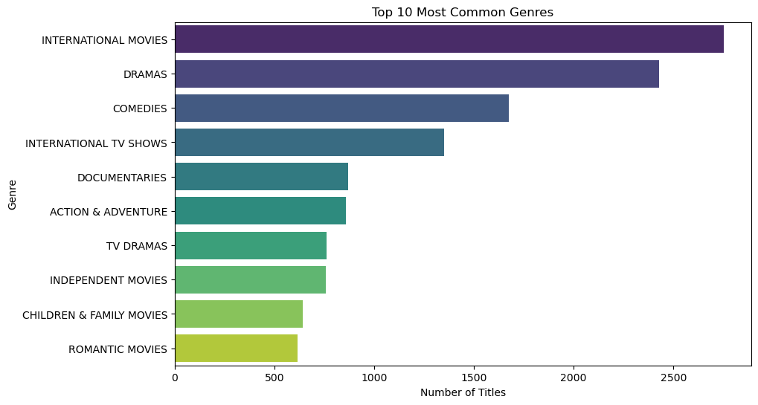
Top 10 Most Common Genres
The bar chart highlights the top 10 genres that dominate Netflix’s offerings.
We can see that genres like "Drama," "Comedy," and "Documentaries" are most common.
Netflix can leverage on the popularity of these genres by continously investing in similar titles belonging to these genres.
Netflix may also explore other opportunities such as diversifying offerings in less common genres.

Slide 19
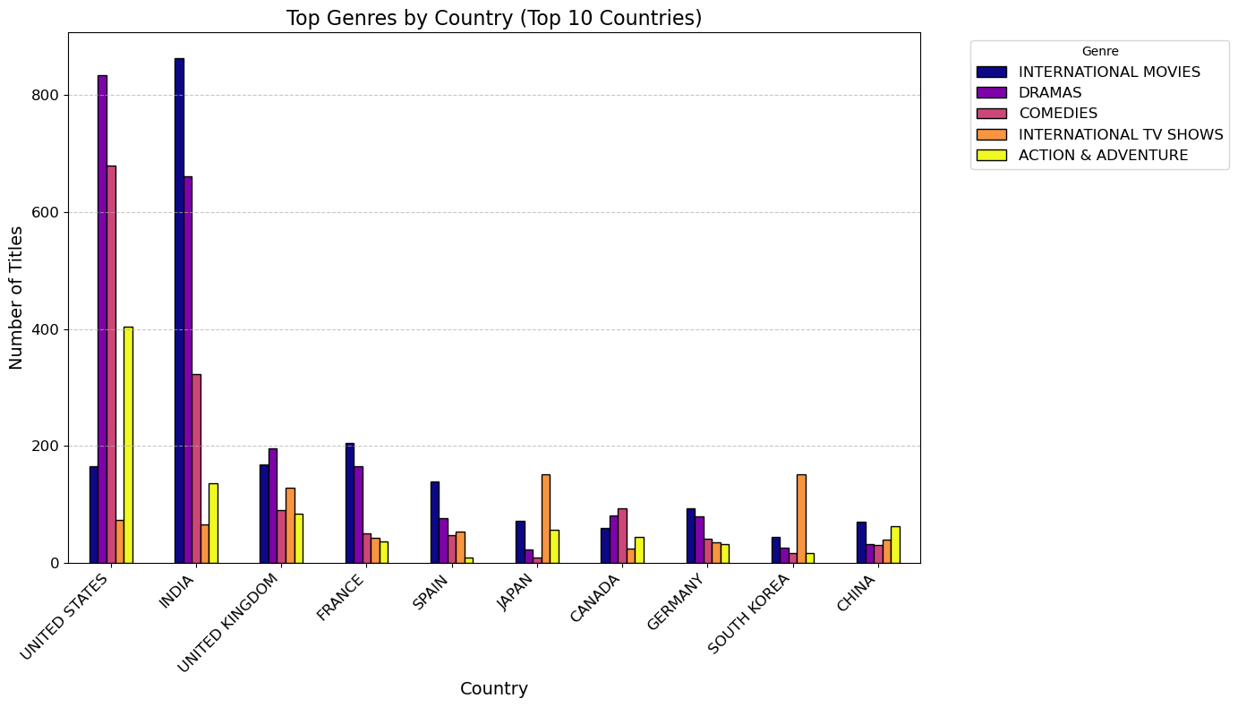
"Drama" and "Comedy" are popular amongst most the countries.
This plot showcases top genres across the top 10 countries (which contributed the most titles to the Netflix Dataset/catalogue).
Some insights discovered were that certain genre such as "Drama" and "Comedy" are popular amongst most the countries. Whereas genre such as "International Movies" has stronger regional appeal.
Netflix can consider regional preferences moving forward when curating content and/or develop original titles tailored to specific countries.

Slide 20
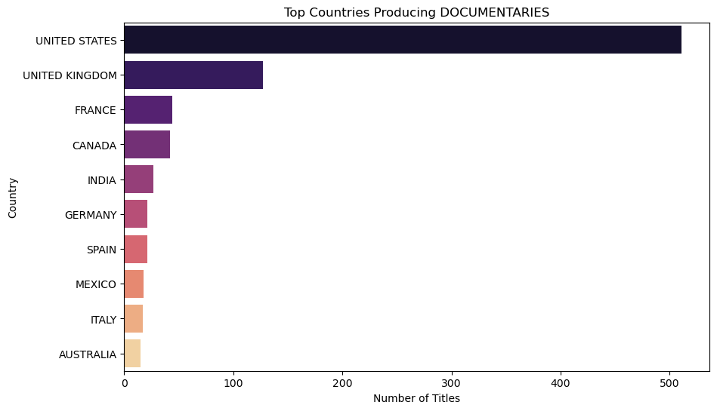
US and UK are leading in producing documentaries
Countries such as the United States (US) and the United Kingdom (UK) are leading in producing documentaries, which is likely due to their established film & media industries and global reach.
Netflix should focus on acquiring more documentaries from the US/UK to not only expand their library of documentaries but also work on gaining more popularity among viewers.
(Recall that documentaries are top 5 of the most popular genre as seen in the first plot!)

Slide 21
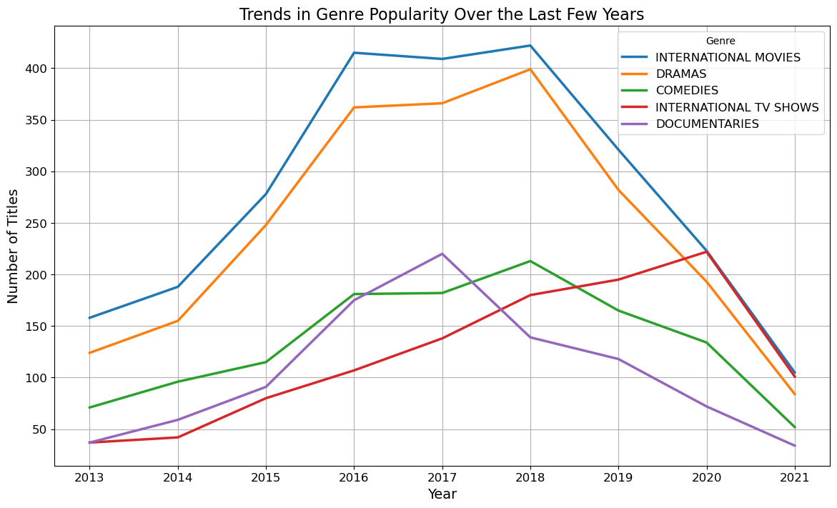
Growing interest in "Documentaries" and "International Movies” genre
Based on the analysis, there is a growing interest in genres like "Documentaries" and "International Movies," signalling a shift in audience preferences towards more diverse and factual content.
To capitalize on this trend, Netflix should consider increasing investment in these emerging genres. Additionally, it may be wise to re-evaluate and potentially scale back investments in genres that are experiencing a decline in demand.
This strategic adjustment could help Netflix better align with evolving viewer interests and maintain its competitive edge.

Slide 22
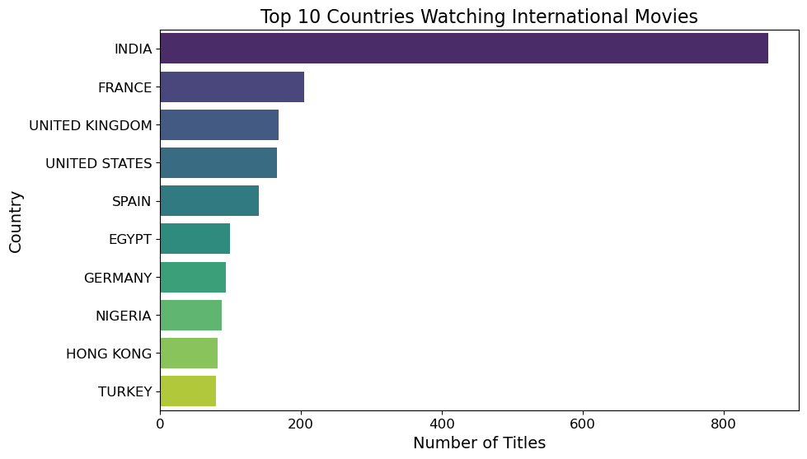
Growing interest in diverse global content
Our analysis reveals that countries such as India and France are among the top 10 with the highest engagement in watching international movies. This reflects a growing interest in diverse global content.
To tap into this trend, Netflix should consider expanding its international content offerings in these key markets.
Enhancing localization efforts could further appeal to these audiences, strengthening Netflix's global reach and engagement.

Slide 23
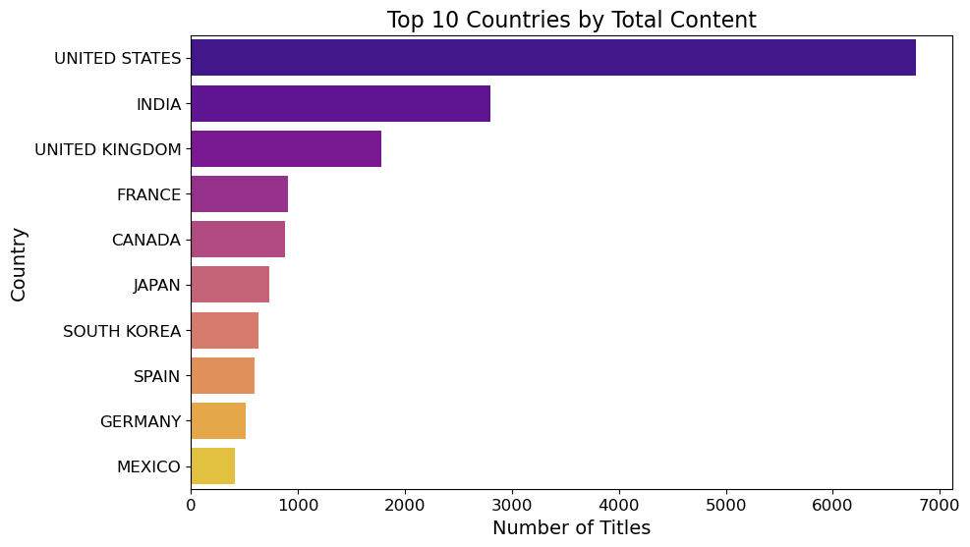
Netflix needs a robust and DIVERSE catalogue
Our analysis still shows that the United States and India are the top contributors to Netflix’s overall content library, highlighting their dominance in content production.
It also further reinforces our point made in plot 5, which is crucial for Netflix to maintain a robust and diverse catalogue, and continue to strengthen partnerships in these regions.
By doing so, Netflix can ensure a steady flow of high-quality content that resonates with its global audience.

Slide 24
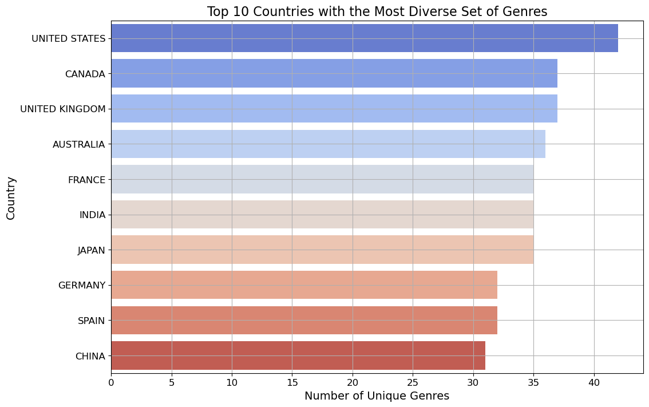
Top 10 countries with the Most Diverse Set of Genres
The analysis shows that the US and UK are leading in a diverse range of genres, reflecting their multicultural societies and well-developed entertainment industries.
Netflix may want to leverage on this diversity by pouring resources into its global marketing strategies which promotes titles from the US/UK.

Slide 25
Actions for Netflix to take
Increase Investment in Emerging Genres
Reevaluate Declining Genres
Expand International Content Offerings to Key markets
Strengthen partnerships with Content Powerhouses
Tailor Content Curation + Marketing Efforts to Regional Preferences
PROBLEM STATEMENT

Slide 26
Limitations

Slide 27
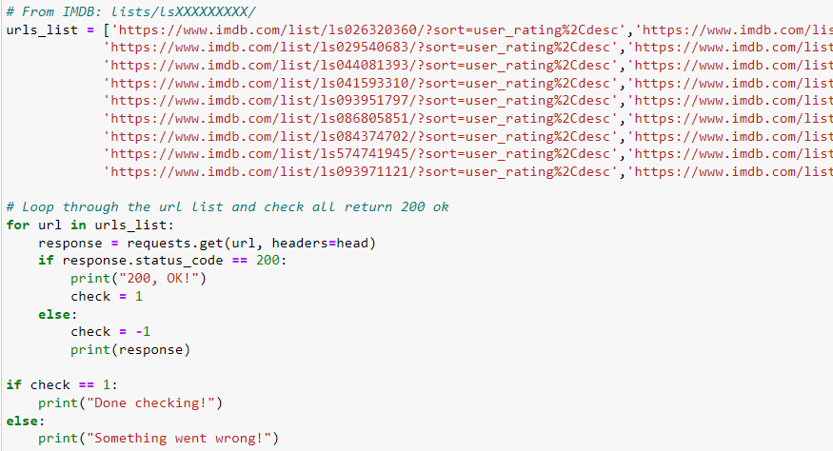
Data scraping on IMDB Listicles
BeautifulSoup – BS4
Requests

Slide 28
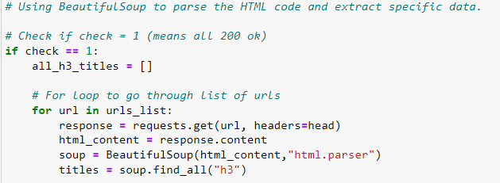
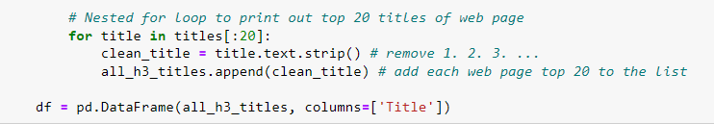
DATA SCRAPING

Slide 29
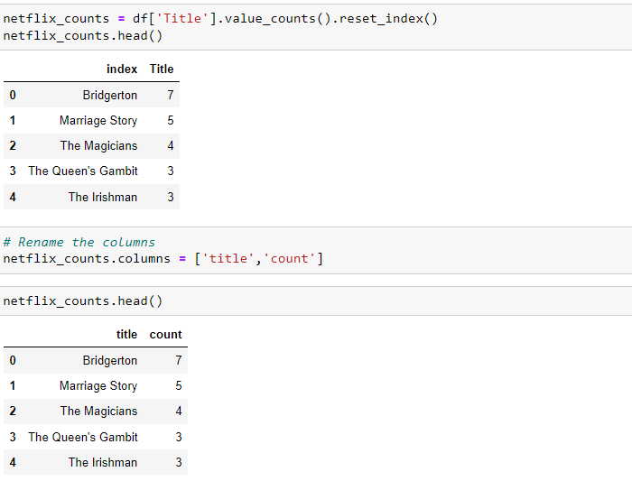
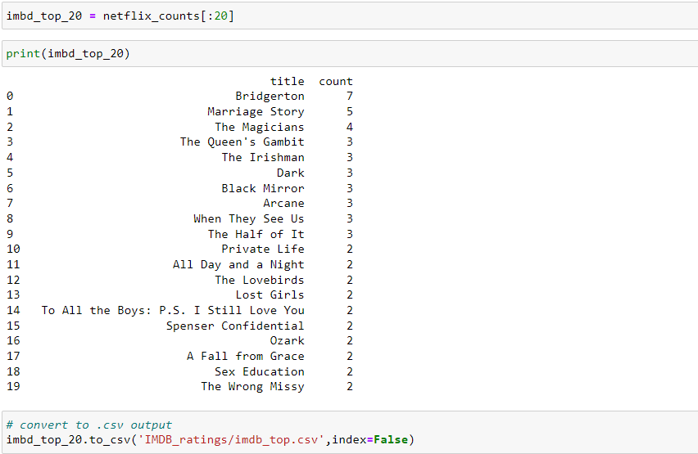
DATA SCRAPING

Slide 30
Are you still watching?
The End
Thank You!

